Slide 1
How to Install Plugins for FlowJo
Eric Haas
LMA CyTOF Core
5/1/2020

Slide 2
Steps to Success
Visit FlowJo Exchange and download the plugin of your choice
Navigate to the download location and copy the .jar file to the “plugin” folder located in the FlowJo program file for the version in use
Open the plugin Readme file and review
If R is needed for the plugin, download R
Copy and paste the R-script from the Readme into R or Rstudio and install packages
Inside of FlowJo, navigate to preferences and set the R path to the correct R folder and check plugins folder location
Restart FlowJo and Plugins should be ready!

Slide 3
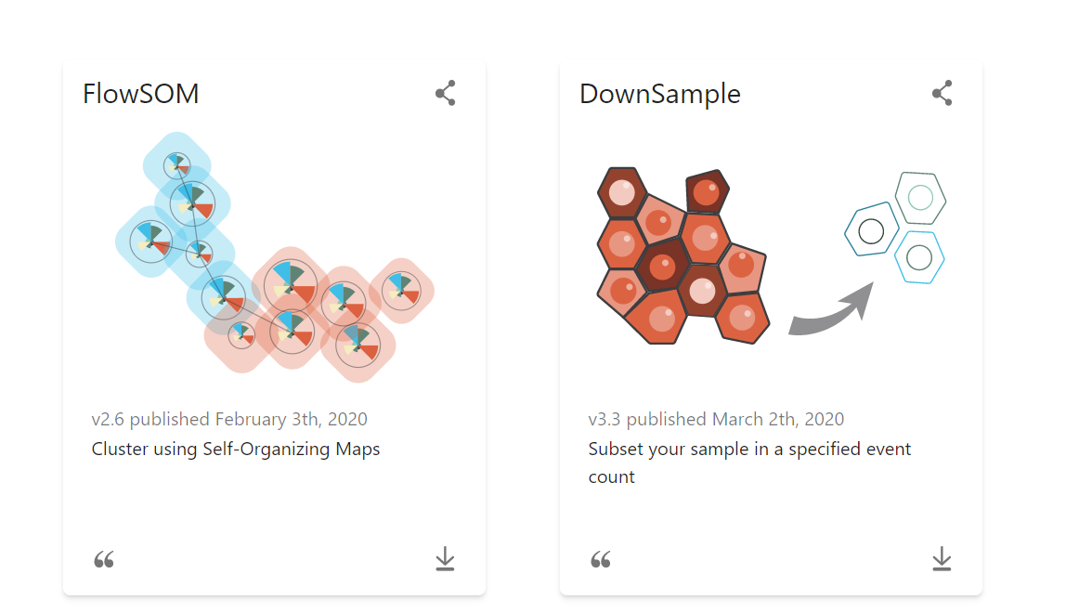
Step 1. Download Plugin
Navigate to the FlowJo Exchange
Download the plugin of your choice

Slide 4
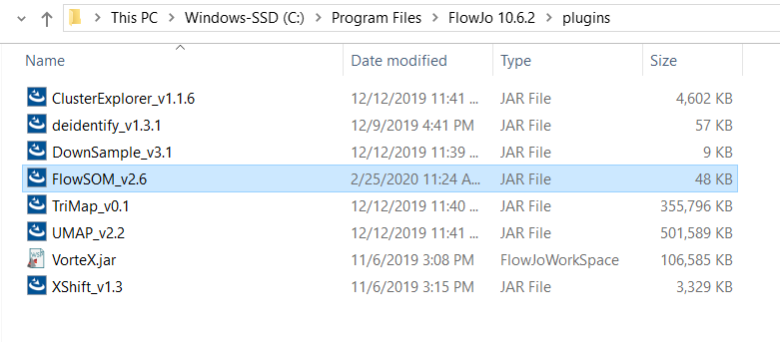
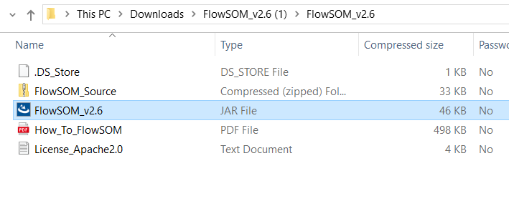
Step 2. Move downloaded plugin to the FlowJo plugin folder
Copy “.jar” file
Paste into the proper FlowJo plugin folder

Slide 5
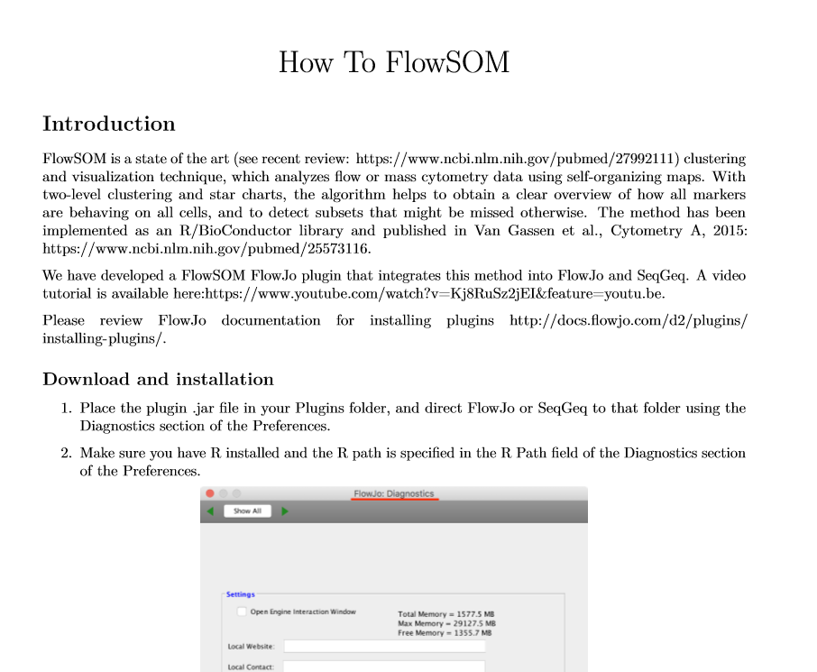
Step 3. Read Readme
Review the Readme downloaded with the plugin and follow the instructions
For FlowSOM, some R packages are needed

Slide 6
Step 4. Download R
Navigate here and download the CRAN site closest to you

Slide 7
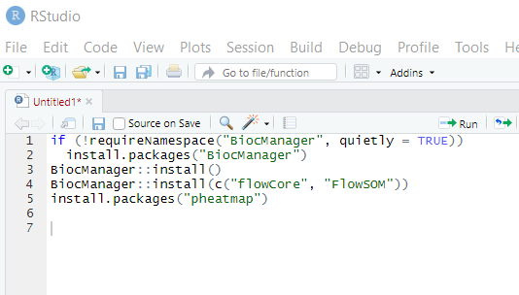
Step 5. Install R packages
Copy the R-script from the readme and open R or Rstudio
Rstudio is a separate download which allows for easier use of R
Run R-script, if updates are required, input “y” for yes and “a” for all if prompted

Slide 8
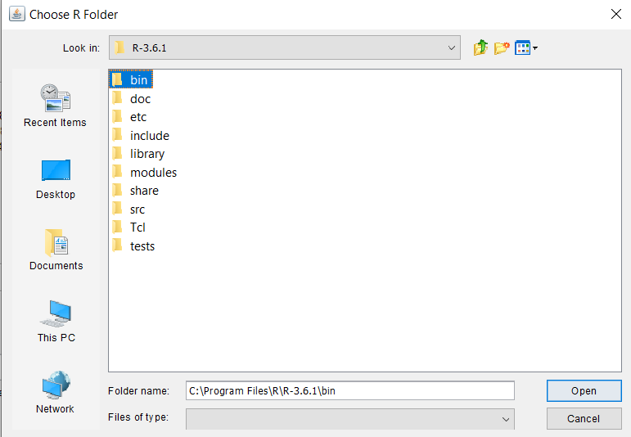
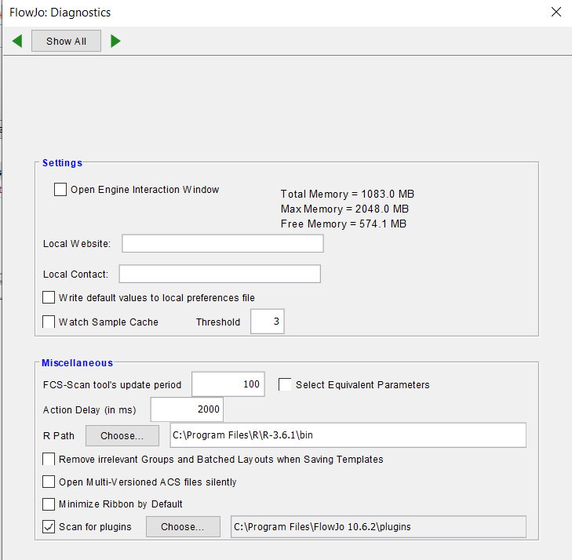
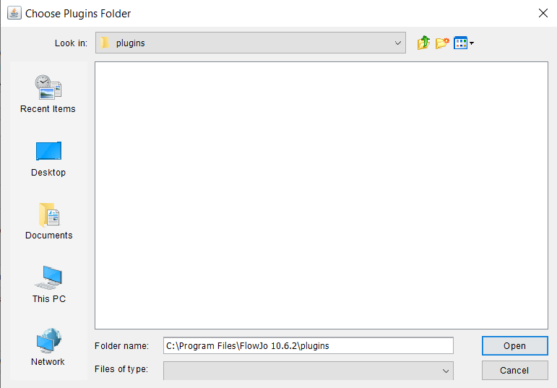
Step 6. Open FlowJo and Set R Path & Check Plugin Folder Location

Slide 9
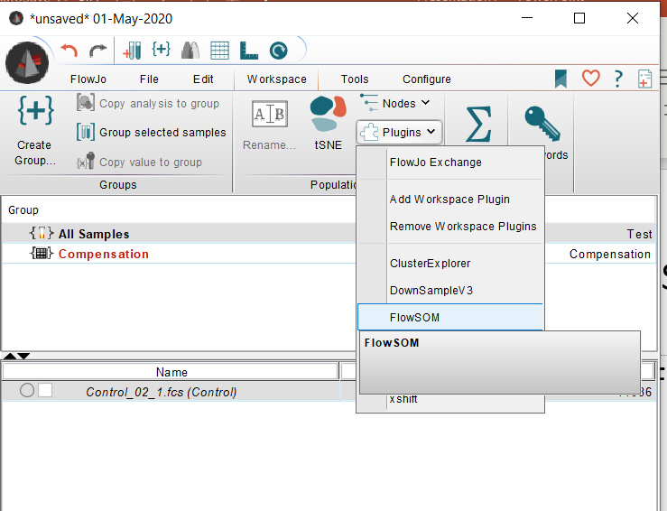
Step 7. Restart FlowJo and Use Plugins
Load a file in FlowJo
Select file/population of interest and navigate to the “plugin” tab in the “workspace” ribbon
Select the plugin of choice and use accordingly

