Slide 1
Don’t Ignore the Iridium Seminar #4
Advanced CyTOF Analysis Workflow Tutorial
Eric R. Haas
Dana-Farber Cancer Institute
Longwood Medical Area CyTOF Core

Slide 2
Why is this Workflow Useful?
Main Idea:
This analysis workflow is intended for users interested in comparing samples from different time points, treatment groups, or a combination of different experimental conditions.
How can this be implemented:
This analysis can be used to compare antigen intensity, population percentages, or any statistic that may be of interest.

Slide 3
Review of Steps to be Completed Prior to this Analysis
Experiment was designed, considering which controls are needed and which samples are to be analyzed in order to provide meaningful information in the context of the study
Panel was designed appropriately, keeping in mind potential spillover and proper antibody-isotope pairs
Panel was thoroughly titrated on samples as similar as possible to experimental samples. Titrations were used to inform antibody concentrations which maximize the signal to noise ratios for each marker
Experimental samples have been acquired and cleaned appropriately (see Seminar #1 )

Slide 4
High-level Overview of Analysis Workflow
Data files are cleaned to live, intact, single cells (previously completed)
Files are assigned a Group ID keyword based on which experimental group each sample belongs to (ex. “Pre-” and “Post-” treatments)
Samples are concatenated into one file
T-SNE is performed on concatenated file
Clustering is performed on concatenated file
Individual samples are exported as new files, with new T-SNE parameters
Apply clustering or gating analysis performed on concatenated file to all exported individual files
Clusters, statistics, and intensities can now be compared visually and qualitatively between samples/groups

Slide 5
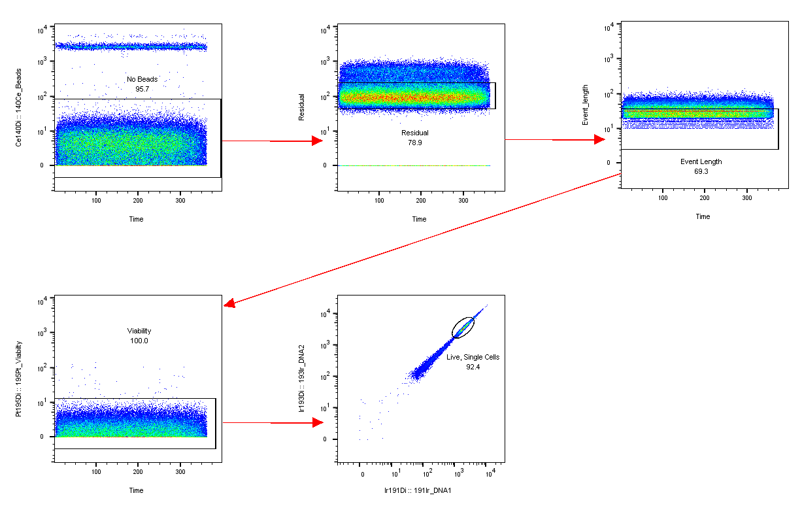
Step 1. Cleaning
Data should be cleaned to include only viable, single cells

Slide 6
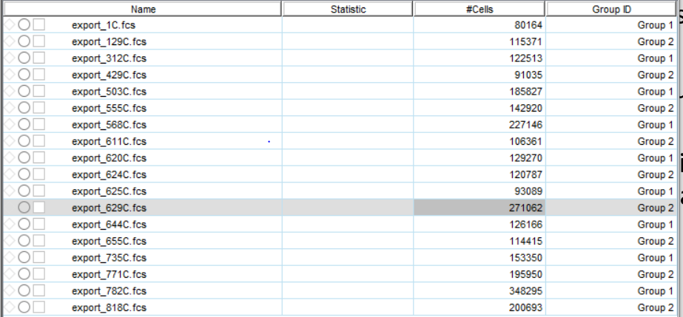
Step 2. Assign Group ID to samples
Navigate to FlowJo tab, select “Experiment” button, and “Add Keyword”
Name keyword what you wish, to keep track of different groups, e.g. “Group ID”
Input Group ID information for each sample to be concatenated (“Timepoint X”, “Pre-Treatment”, etc.)

Slide 7
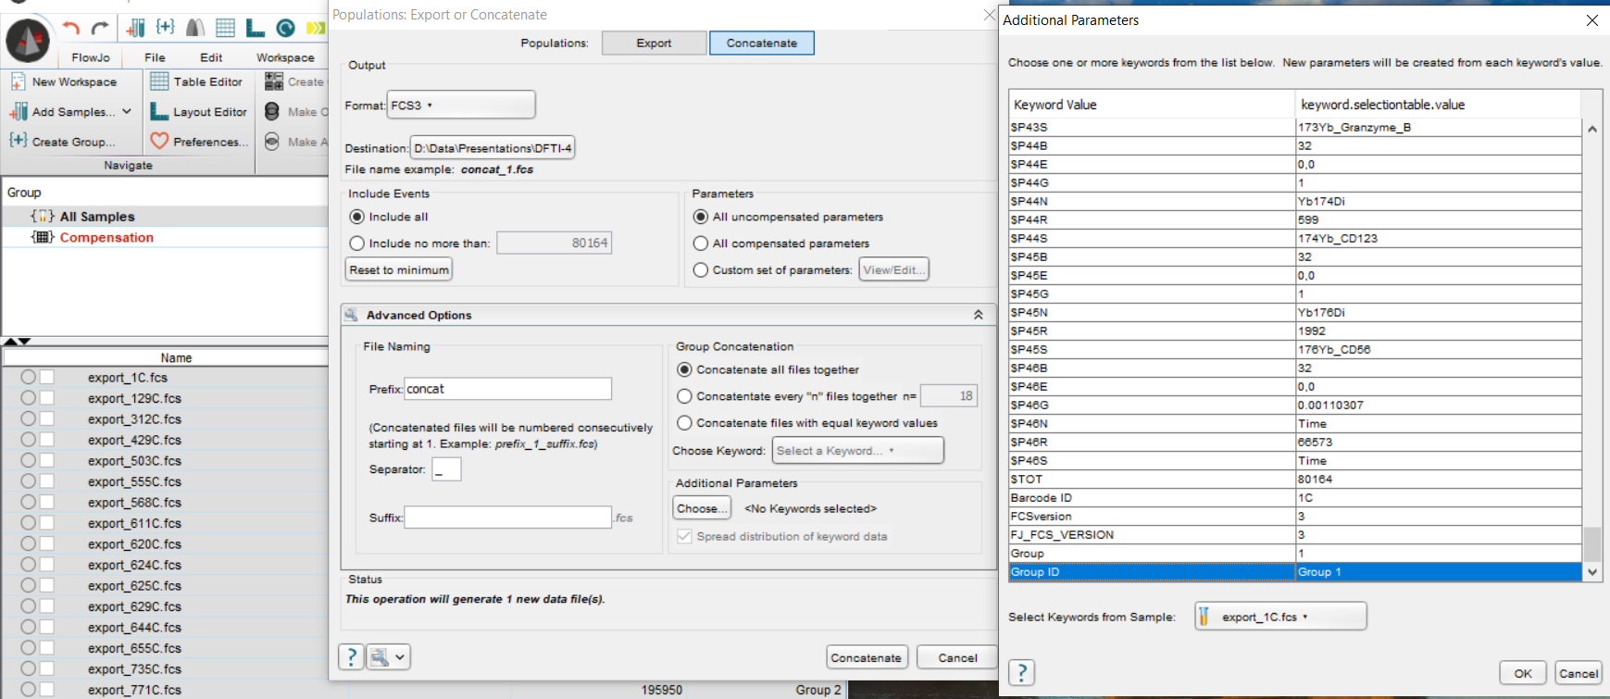
Step 3. Concatenate Samples
Select all samples, right click, and select export/concatenate populations
Navigate to “Concatenate”, choose the destination to save your file, select all uncompensated parameters, and select the keyword used to label sample groups under the “Additional Parameters” tab
Then select the “Concatenate” button
Optional down-sample at this stage (using “include no more than” option) to include equal numbers of events for each file

Slide 8
Step 4. Perform t-SNE on concatenated file
With the concatenated file selected, navigate to the “Workspace” ribbon and select tSNE
Choose your tSNE parameters (typically at least all phenotyping markers, however, I like to choose all markers for greater resolution)
Change the KNN algorithm to ANNOY, learning rate to 10% of the total event count, and gradient algorithm to Fit-SNE (these settings allow tSNE to run faster, without compromising the integrity of the analysis)
Select “Run” and wait…

Slide 9
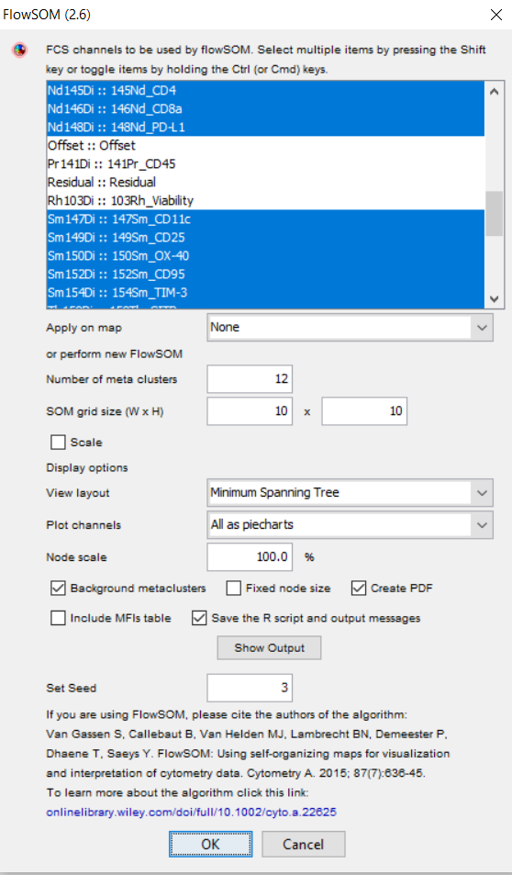
Step 5. Perform Clustering on concatenated file
After installing (and following the readme) the clustering plugin of choice from FlowJo Exchange, navigate to the “Workspace” ribbon and select your plugin from the “Plugins” dropdown menu
Select the parameters you wish to perform clustering on (for FlowSOM, you also need to input how many meta-clusters to use
While the number of meta-clusters may be unknown, it is better to input a higher number, then compare clusters to determine if the file is “overclustered”, at which point the analysis can be re-performed with less meta-clusters

Slide 10
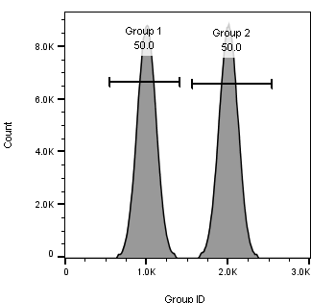
Step 6. Export Individual Samples
Create a histogram with Group ID on the x-axis, right-click in the window, and select auto-gate on peaks (there should be N peaks, N=number of groups)
Export each newly created gate as a new sample, select all uncompensated parameters, which will export the newly created tSNE parameters

Slide 11
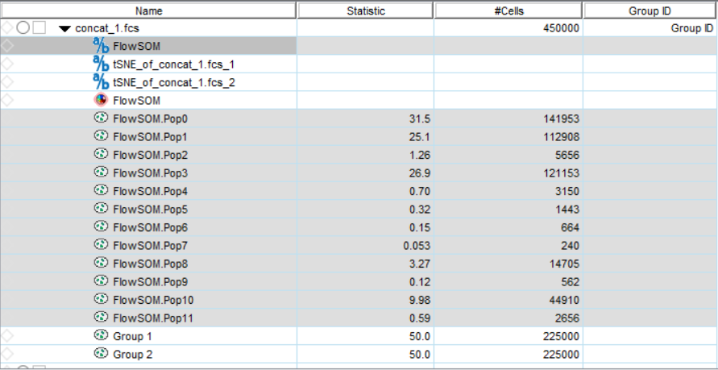
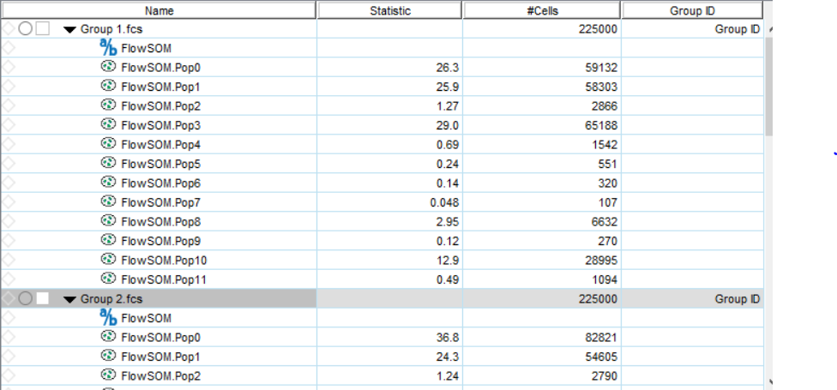
Step 7. Apply clustering or gating analysis performed on concatenated file to all exported individual files
Copy the FlowSOM meta-clusters and the FlowSOM parameter from the concatenated file and paste them to each group

Slide 12
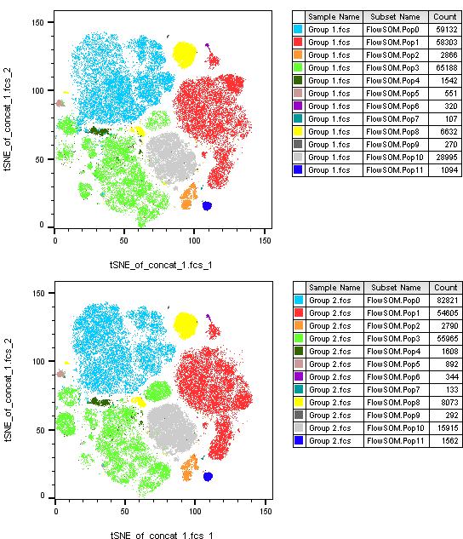
Step 8. Compare samples or groups and visualize with tSNE
Compare marker intensity, cell population frequencies, cluster frequencies, or any other parameters between groups or samples

Slide 13
Analysis Workflow Review
Samples were labeled, combined, and analyzed together
This analysis was used to gain insight into differences between samples or sample groups
These results can be quantified and further analyzed in the statistics software of your choice
Results from this analysis can be used to power more informed conclusions about the experiment

Slide 14
Questions?
Please feel free to contact me with any questions at: ericr_haas@dfci.harvard.edu or CyTOF@dfci.harvard.edu
For FlowJo™ plugins, please visit the FlowJo Exchange: https://www.flowjo.com/exchange/#/
For our previous data analysis seminars, please visit our website: https://lma-cytof.dana-farber.org/core-videos.html

Slide 15
Acknowledgements
Dana-Farber Cancer Institute Flow and CyTOF Cores
Dana-Farber Cancer Institute Center for Immuno-Oncology Immune Assessment Lab (CIO-IAL)
John Quinn, PhD, FlowJo™

